Slide 1
Relation Extraction using a Linear SVM
Kavin Kuppusamy
Derek Carpenter
University of Texas at Dallas

Slide 2
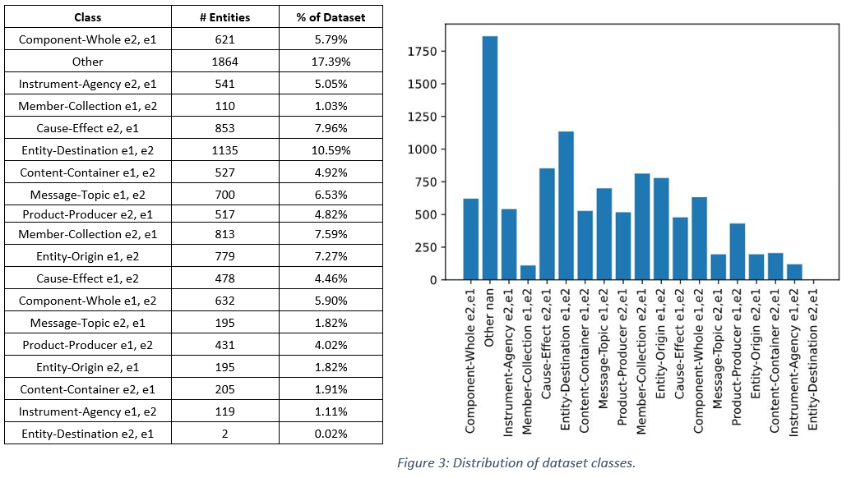
Distribution of dataset

Slide 3

Lexical Features
Entities: we extracted the annotated nominals from the given sentences. If the entity is composed of more than one word, we parse the noun phrase and take the head word.(eg., San Jose University -> University).
Entity Tag: Using NLTK POS tagger, we attached Part of Speech Tag for each entity.
Words between nominals: Using the words between the nominals is a highly relevant feature regarding a relation in a sentence.
Prefix of Length 5: Using the prefixes of length 5 for the words between the nominals provides a kind of stemming (produced -> produ, caused -> cause). This stemming effect reduces the complexity of our features and generalizes the words, producing a better generalization of other potential similar relations.
Distance between nominals: The number of words between the two entities mentioned.
POS Tag Between: we extract a coarse-grained part of the speech sequence for the words between the nominals. This feature is produced by extracting the first letter of each token’s POS tag.
Words before E1, After E2, Before E1, and Single word after E2: Extracting all the tokens before the e1 entity, after the e2 entity, and all the tokens before e1 and a single token after e2.

Slide 4

WordNet Features
E1 and E2 Hypernyms: Using the wordnet package, we extract hypernyms for both e1 and e2.
Lowest Common Hypernym: Wordnet's lowest_common_hypernyms method is based used to locate the lowest single hypernym that is shared by two given nominals.
Wu-Palmer Similarity: It calculates relatedness by considering the depths of the two synsets in the WordNet taxonomies, along with the depth of the LCS (Least Common Subsumer). The score can be 0 < score <= 1. This feature mainly helps in finding how similar are the given two nominals.

Slide 5

Dependency Parsing
Dependency Path length1: Using Spacy and networkx, produced the dependency parse tree and find the shortest path dependency between two entities. This feature mainly helps in finding the parent node which connects the two entities.
Dependency Path length2: Encode the complete path between e1 and e2 including dependency features.
Connecting Path: Finding the tokens between the two entities from the path extracted by shortest path dependency.
SDP Root Node Lemma: This feature will extract the lemmatized head word of the phrase/token connecting two entities in the two entities.
Shortest Path Length: This feature will reveal that the shortest path length given the dependency parse.
Root word Location: This feature will give the location (BEFORE, BETWEEN, AFTER) of the root word between two entities, found from dependency parse
Levin Class ids and class name

Slide 6
Feature Extraction
Features |  | Examples
Lexical Features | e1 | fire
 | e2 | fuel
 | before_e1 | The
 | after_e2 | .
 | word_outside | [The, .]
 | prefix5between | [insid, WTC, was, cause, by, explo]
 | distance_between | 6
 | e1_tag | NN
 | e2_tag | NN
Wordnet Features | HyperE1 | [bake.v.01,passion.n.01,chase_away.v.01,combustion.n.01,element.n.05,happening.n.01,trial.n.06,criticism.n.01,remove.v.02,destroy.v.02,supply.v.01,blast.v.07,fireplace.n.01,attack.n.01,fuel.n.01,make.v.03]
 | HyperE2 | [stimulate.v.03, take_in.v.12, substance.n.07, supply.v.01]
 | lc_hyper | entity.n.01
 | max_entity_sim | 1
Dependency Parse | dep_path_len1 | [cause->nsubjpass->E1, cause->dobj->E2]
 | dep_path_len2_location | E1_nsubjpass_BETWEEN_dobj_E2
 | connecting_path | caused by exploding
 | sdp_root_lemma | cause
 | e1_dep | nsubjpass
 | e2_dep | dobj
 | shortest_path | [fire, caused, by, exploding, fuel]
 | shortest_path_len | 4
 | root_word_location | BETWEEN

Slide 7
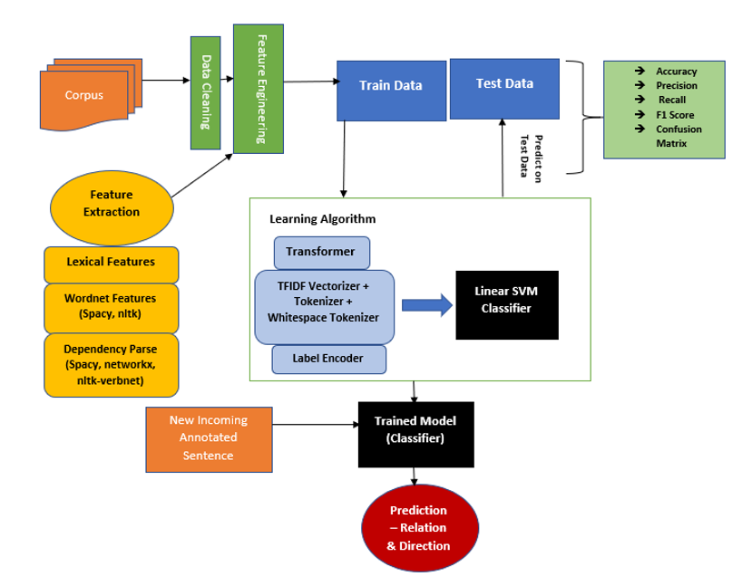
Model Architecture

Slide 8
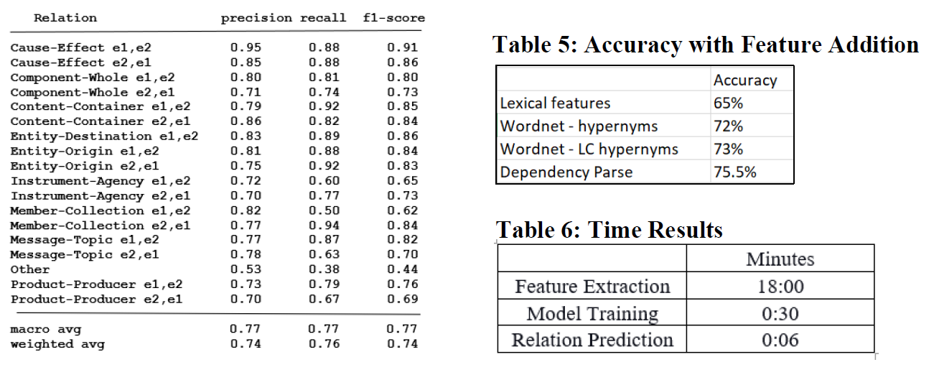
Experiment Results

Slide 9

Experiment Analysis
With the Confusion matrix attained, we see that precision on ‘OTHER’ class was low because of the dataset having more bias towards the ‘OTHER’ class (17.3%). (Shown in the figure3).
The precision of below classes are less compared to other class, we couldn’t have extracted the features to support the below classes.
Component-Whole e1,e2
Instrument-Agency
Product-Producer e2,e1

Slide 10
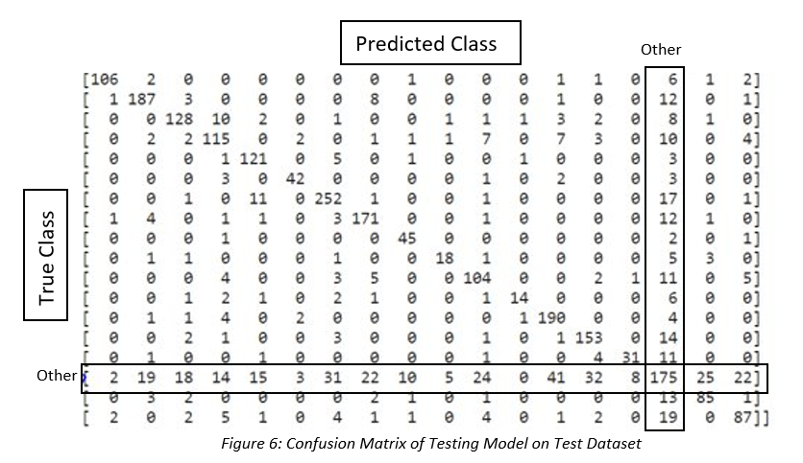
Confusion Matrix

Slide 11
Potential improvements
Because of the dataset having bias towards ‘Other’ class, we can experiment with
Random Under sample using imblearn
Random Oversample or SMOTE technique
SMOTE is not very good for high dimensionality data
Overlapping of classes may happen and can introduce more noise to the data.
Assign weights for the class manually with the ‘class_weight’ parameter.
Class weights modify the loss function directly by giving a penalty to the classes with different weights. It means purposely increasing the power of the minority class and reducing the power of the majority class. Therefore, it gives better results than SMOTE.

Slide 12
Thank you!

